Slide 1
Prewriting Techniques
Ramadhani Uswatun Khasanah

Slide 2
Prewriting
Prewriting is part of the writing process in which the writer gathers ideas, explores the writing prompt, generates thoughts, and organizes them.

Slide 3
Why is it important?
Prewriting allows us to explore, test, and generate ideas. These are the ways to organize and expand on their writing.

Slide 4
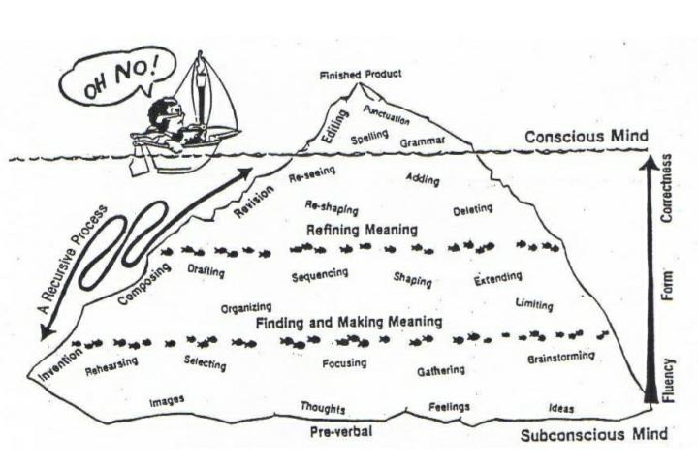

Prewriting techniques:
Free Writing
Listing
Clustering

Slide 5
Free Writing
Free writing is writing continuously, spontaneously, letting thoughts unselfconsciously flow (often for about 5 to 10 minutes) without regard to spelling, grammar, style etc., and no corrections are made. Free writing allows you the freedom to discover what you want to write about without worrying about rules or expectations.

Slide 6
How do you do it?
Decide your topic and set a timer (usually 5-10 minutes)
Start to write in a blank piece of paper (as many as possible)
Try to keep writing without stopping, Don’t read, edit, or evaluate what you are writing.
When the time is up:
Read back over it and look for ideas that related your topic.
Underline/circle those ideas.
Connect between similar ideas.

Slide 7
Example:
Topic: the life of Frederick Douglass
Frederick Douglass has learned to read and after he reads a speech by Sheridan, he sees that his human rights have been taken away by slavery. He began to hate his enslavers. He says they are robbers who took Africans from their homes and brought them to America to enslave them and take away their human rights. Once Douglass can read, his thinking skills are stronger because he is exposed to ideas beyond his own experiences, and his understanding of the oppressive nature of slavery is even stronger. He says that his Master Hugh was right – he feels a powerful feeling of discontentment that is so painful that he almost wishes he were illiterate EXAMPLE and didn’t know how to read and think. He is overwhelmed by what he realizes and says he wishes at times he was ignorant because he is tormented by the horror of slavery. It is ironic because slavery is dehumanizing and Douglass says he almost wishes he didn’t know what he knows and could stay ignorant. This makes me think about how reading and thinking help to liberate and enlarge our minds, and that is why in many countries run by dictators there is a high rate of illiteracy. If people are kept illiterate, they can be oppressed more easily. Being exposed to ideas can promote consciousness, which can lead to action. Frederick Douglass was changed forever by his ability to read, write and think about his situation as a slave. This makes me think how all of us are enslaved in one way or another, and that by reading and thinking about it, we can free ourselves.

Slide 8
Ideas for an essay topic drawn from this example of free writing:
How learning to read, write and think about ideas is a liberating experience
How anger and discontentment can fuel awareness and action
• The power of ideas to build consciousness
• The irony of Frederick Douglass wishing to be a “beast” because of the painful truths he realizes about the dehumanization of slavery

Slide 9
Listing
Listing helps you to select certain ideas and organize them by
grouping related concepts together. This is the most informal kind of outline in which you jot down
your main supporting points and possible evidence and analysis.

Slide 10
How do you do it?
Set a timer (usually 5-10 minutes)
Start to write in a blank piece of paper or computer screen. Begin making a list of everything you would like to write.
Use keyword or phrases, it’s not necessary to write in complete sentence.
When the time is up:
Go back and organize your list into logical units
Add quote, example, or information

Slide 11
Example:
Topic: Communication
Many different ways
What’s best?
Cell-phones – photos
Texting – too much! Addiction in society?
Talking – fun, face to face, friends
Letters – write grandma
Different purposes?
Problems communicating

Slide 12
Clustering
Clustering, also known as mapping, is like listing in that you narrow down and begin to organize your ideas. Cluster/mapping provides a mental picture of the ideas you generate and how they connect to
each other

Slide 13
How do you do clustering?
Choose one topic that you are going to write, and write it in a large circle in the center of a piece of paper.
Think about the topic for one or two minutes. Then write each new idea that comes into your mind in smaller circle around the large circle.
Think about the idea in each smaller circle for one or two minutes. Write any new ideas in even smaller circles.
Look over your groups of circles. Which group is largest? The largest group of circles is probably the most productive topic for your paragraph.

Slide 14
Example:
breakfast
Topic: a place from my childhood
garden
Mrs. eliza
After school
teachers
kitchen
First house
dark
school
stairway
Childhood place
narrow
My bedroom
high
lady
Friend house
Park
view
eye
staring

Slide 15
Let’s practice
Decide the topic and try your hand at clustering or listing or free writing.

